Slide 1
CNN 분류기
개발 프로젝트
전자정보공학부 IT융합전공 박준혁 (20170590)
AI융합학부 김혜빈 (20192897)
AI융합학부 이찬도 (20160391)

Slide 2
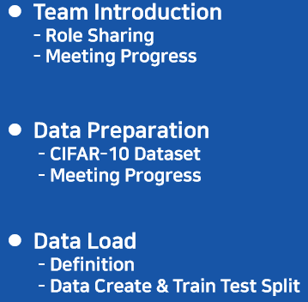
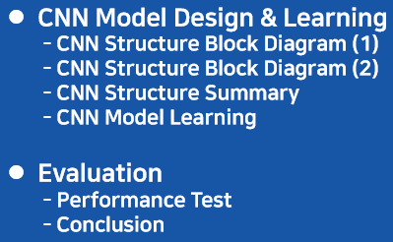
목차
CNN Model Design & Learning
- CNN Structure Block Diagram (1)
- CNN Structure Block Diagram (2)
- CNN Structure Summary
- CNN Model Learning
Evaluation
- Performance Test
- Conclusion

Slide 3
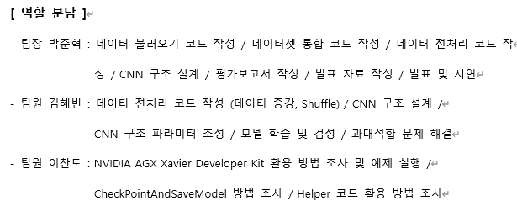



Team Introduction
Role Sharing
Presenter
Programmer
Engineer
Notes:
Set initial coordinates to reset coordinates by district to values between 0 and 15. and Store the result of the distance between the map and coordinates of each district. Finally, creating a map and a Q table for each district. The lower right capture is the code output result.

Slide 4
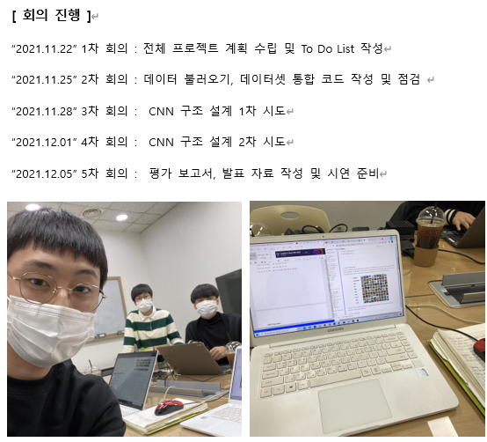
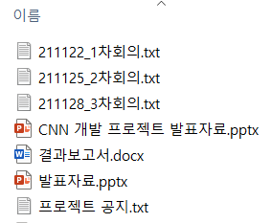
Team Introduction
Meeting Progress
Notes:
Set initial coordinates to reset coordinates by district to values between 0 and 15. and Store the result of the distance between the map and coordinates of each district. Finally, creating a map and a Q table for each district. The lower right capture is the code output result.

Slide 5
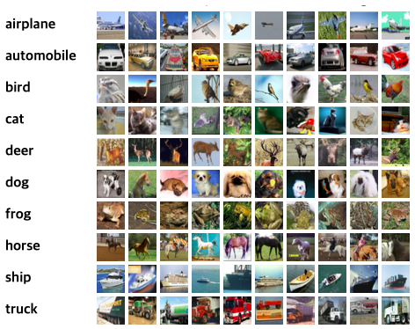
Data Preparation
CIFAR–10 Dataset
데이터 수집 / 준비
CIFAR-10 dataset은 32x32 픽셀의
60,000개 컬러 이미지가 10개의 클
래스로 레이블링 되어 있음.
각 카테고리별 6,000개의 데이터 중
앞에 5,000개는 훈련 데이터, 뒤에
1,000개는 시험 데이터로 사용함.
이렇게 해서 총 60,000개의 이미지를
통해 CNN 분류기를 설계함.
Notes:
Set initial coordinates to reset coordinates by district to values between 0 and 15. and Store the result of the distance between the map and coordinates of each district. Finally, creating a map and a Q table for each district. The lower right capture is the code output result.

Slide 6
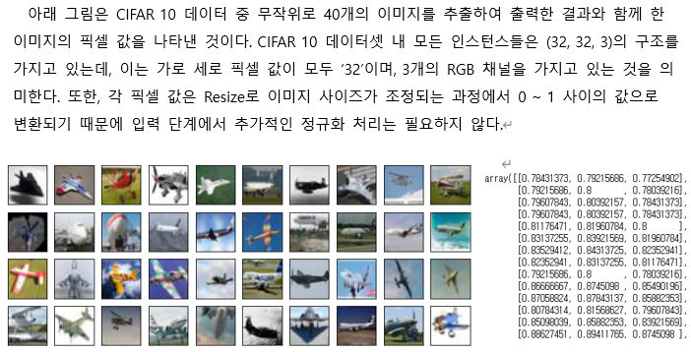
Data Preparation
CIFAR–10 Dataset
Notes:
Set initial coordinates to reset coordinates by district to values between 0 and 15. and Store the result of the distance between the map and coordinates of each district. Finally, creating a map and a Q table for each district. The lower right capture is the code output result.

Slide 7
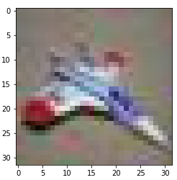
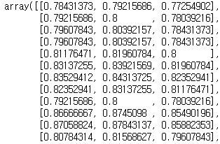
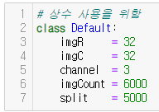
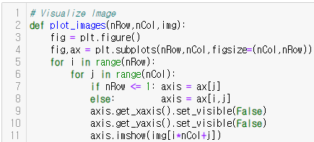
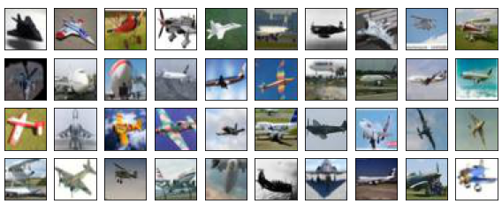
Data Load
Definition
기본 변수 정의
사용자 함수 정의
Notes:
Set initial coordinates to reset coordinates by district to values between 0 and 15. and Store the result of the distance between the map and coordinates of each district. Finally, creating a map and a Q table for each district. The lower right capture is the code output result.

Slide 8
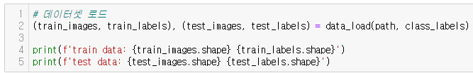
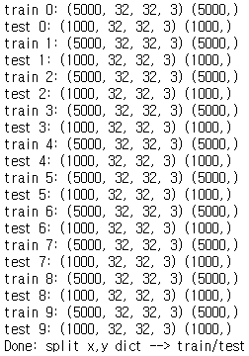
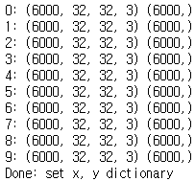

Data Load
Dataset Create & Train Test Split
Notes:
Set initial coordinates to reset coordinates by district to values between 0 and 15. and Store the result of the distance between the map and coordinates of each district. Finally, creating a map and a Q table for each district. The lower right capture is the code output result.

Slide 9
CNN Model Design & Learning
CNN Structure Block Diagram (1)
normalize
normalize
Dropout
normalize
normalize
32
32
32
16
16
16
0.3
8
32
32
32
16
16
16
8
64
32
64
64
32
32
Input Layer
Convolution
Pooling Layer1
Convolution
Pooling Layer2
( Conv1 / Conv2 / Pool1 )
( Conv3 / Conv4 / Pool2 )
3
*
32
*
32
32
*
32
*
32
32
*
32
*
32
32
*
16
*
16
64
*
16
*
16
64
*
16
*
16
64
*
8
*
8
Notes:
Set initial coordinates to reset coordinates by district to values between 0 and 15. and Store the result of the distance between the map and coordinates of each district. Finally, creating a map and a Q table for each district. The lower right capture is the code output result.

Slide 10
CNN Model Design & Learning
CNN Structure Block Diagram (2)
Dropout
Normalize
Normalize
Dropout
Normalize
Normalize
Dropout
Normalize
256
Dropout
8
8
4
128
4
4
2
0.3
0.4
0.3
10
8
8
4
4
4
2
64
0.3
Output
128
64
64
128
128
Convolution
Pooling Layer3
Convolution
Pooling Layer4
Dense
Output Layer
( Conv5 / Conv6 / Pool3 )
( Conv7 / Conv8 / Pool4 )
( Flatten / Dense1 / Dense2 )
128
*
8
*
8
128
*
8
*
8
128
*
4
*
4
64
*
4
*
4
64
*
4
*
4
64
*
2
*
2
256*
1
*
1
128
*
1
*
1
10
*
1
*
1
Notes:
Set initial coordinates to reset coordinates by district to values between 0 and 15. and Store the result of the distance between the map and coordinates of each district. Finally, creating a map and a Q table for each district. The lower right capture is the code output result.

Slide 11
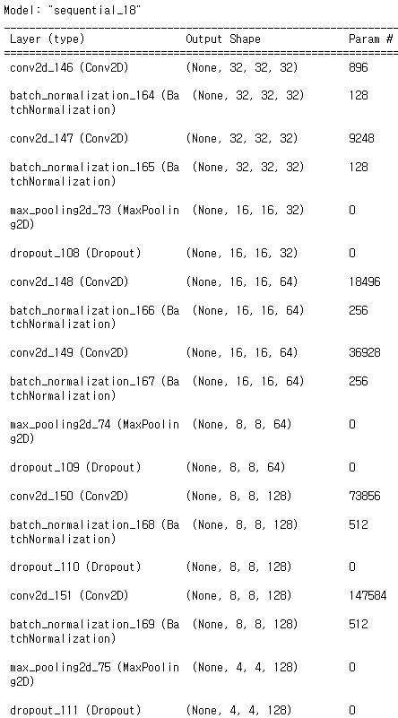
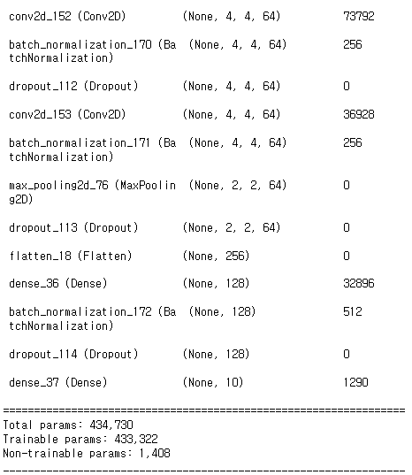

CNN Model Design & Learning
CNN Structure Summary
Notes:
Set initial coordinates to reset coordinates by district to values between 0 and 15. and Store the result of the distance between the map and coordinates of each district. Finally, creating a map and a Q table for each district. The lower right capture is the code output result.

Slide 12
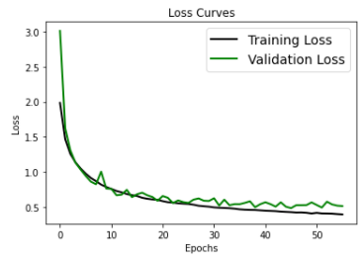
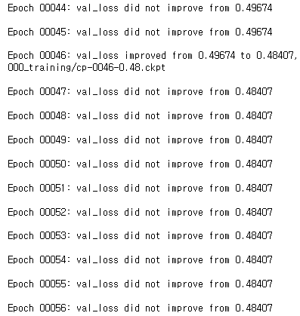
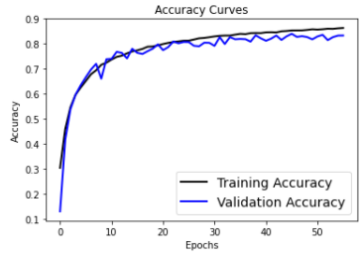
CNN Model Design & Learning
CNN Model Learning
Learning Parameter : Epochs = 500 / Early Stopping.Patience = 10
Notes:
Set initial coordinates to reset coordinates by district to values between 0 and 15. and Store the result of the distance between the map and coordinates of each district. Finally, creating a map and a Q table for each district. The lower right capture is the code output result.

Slide 13
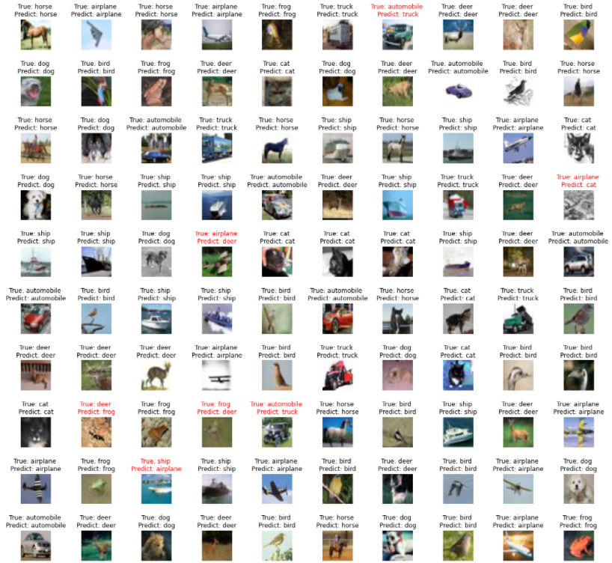
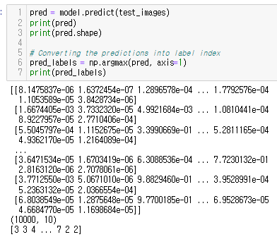

Evaluation
Performance Test
Prediction
Result
테스트 정확도 : 0.904
Notes:
Set initial coordinates to reset coordinates by district to values between 0 and 15. and Store the result of the distance between the map and coordinates of each district. Finally, creating a map and a Q table for each district. The lower right capture is the code output result.

Slide 14
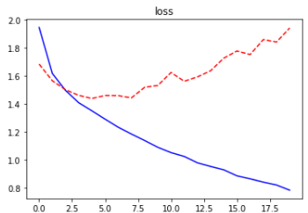
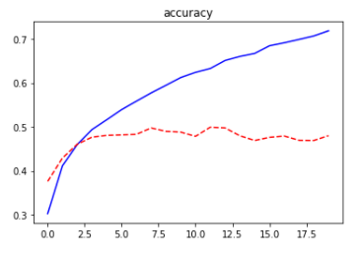
Evaluation
Conclusion
CNN 구조 설계의 중요성
하이퍼 파라미터 조정 없이 Convolution Pooling Layer를 두 개 층만 쌓아 만들었던 초기 모델은 좋은 분류 성능을 보이지 못하였음. 정확도가 0.4 ~ 0.7 사이에서 형성되며, loss 값 역시 튀는 현상이 목격되었음.
따라서 보다 복잡한 CNN 구조를 설계하여 조금씩 파라미터를 조정해가는 방식의 접근이 필요함을 깨달음.
Convolution Pooling Layer를 4개 층까지 확장하고, BatchNormalization, DropOut 기법을 사용하여, 오차 값을 보정하고 과대적합 문제를 해결함.
그 결과, 테스트 데이터 정확도 : 0.904의 높은 분류 성능을 얻음.
Notes:
Set initial coordinates to reset coordinates by district to values between 0 and 15. and Store the result of the distance between the map and coordinates of each district. Finally, creating a map and a Q table for each district. The lower right capture is the code output result.

Slide 15
Thank you

